Slide 1
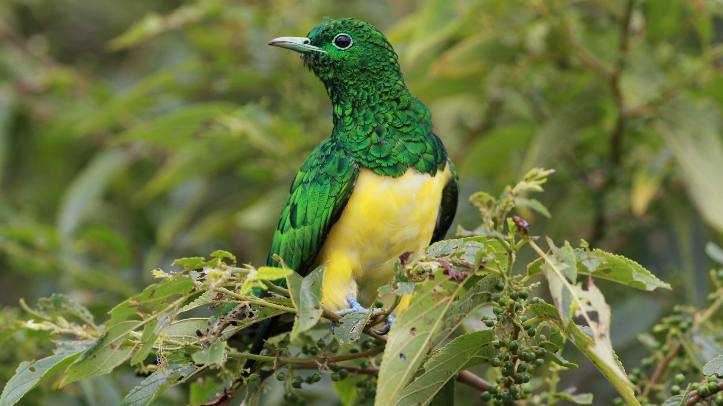
BeakPeek
Millennium
BIRDING MADE EASY AS FLY
Group 22

Slide 2
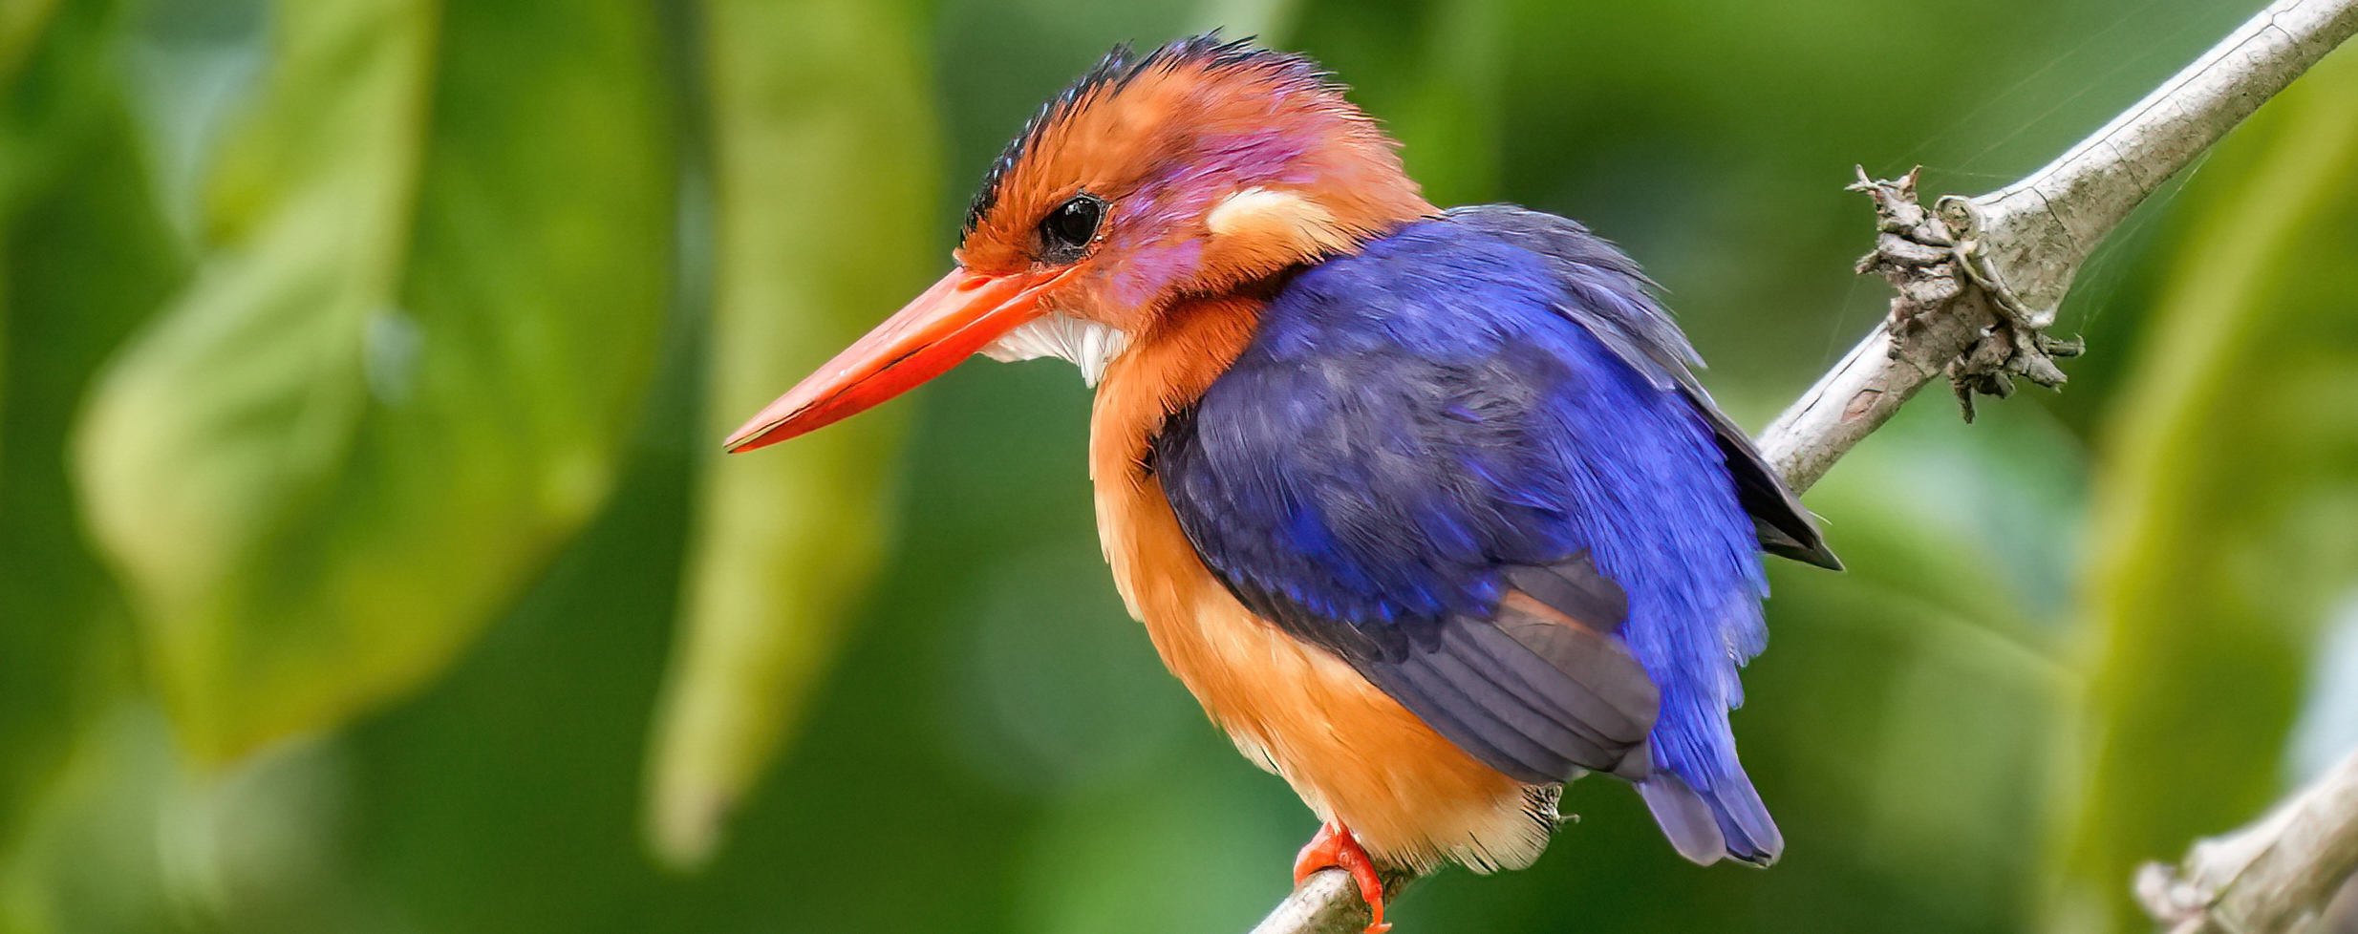



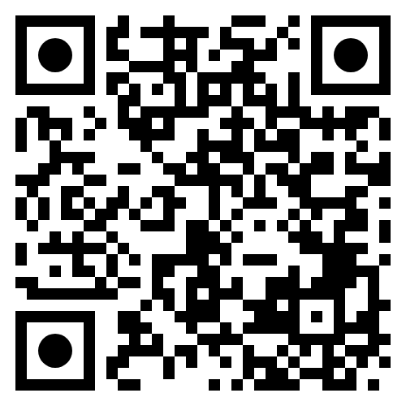
BeakPeek
Vision
Grow Birding 01
Find birds 02
Conservation 03
Grow the bird watching community in South Africa
Make it easier to not only find birds but also learn about them
Allow conservationists to easily access and understand a large amount of data
GITHUB Link
SRS LINK

Slide 3
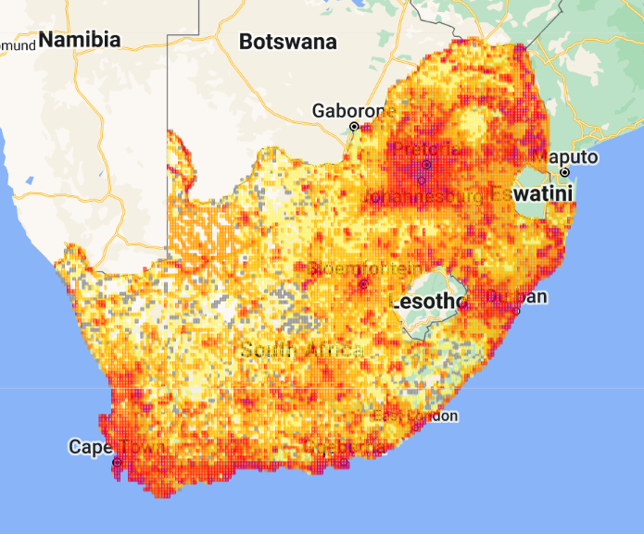

SABAP2 ISSUES
Response time
SABAP2 suffers from an extremely long response time, with some pages taking more than two minutes to load on average!
Beak peek
Millennium
Group 22
Complex, Scattered Information
While insightful, the information offered by the website is overly complex and too scattered for a standard user, with no guide as to what some of the information might even mean, for example the difference between Common Species, Common Group and just Species Name.

Slide 4
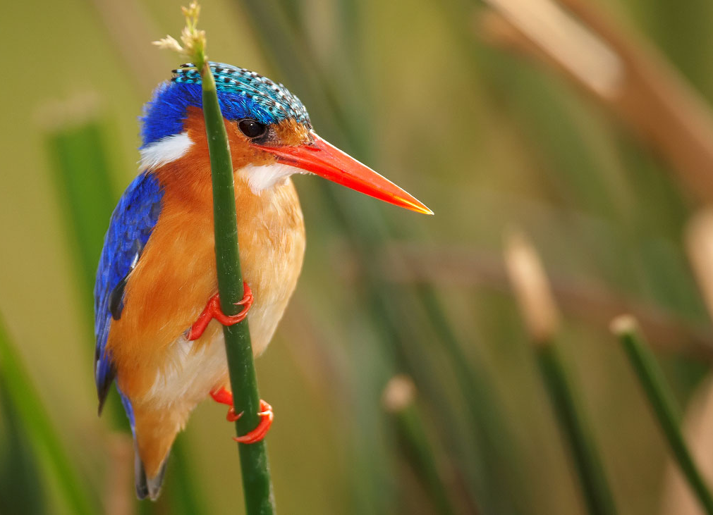
BEakPEEK
USERS
Birders
Conservationists
Administrators
Notes:
We don’t want to throw away all this valuable data, therefore
Easy for birders, but can go deep
Even more all in one place for conservationists!

Slide 5
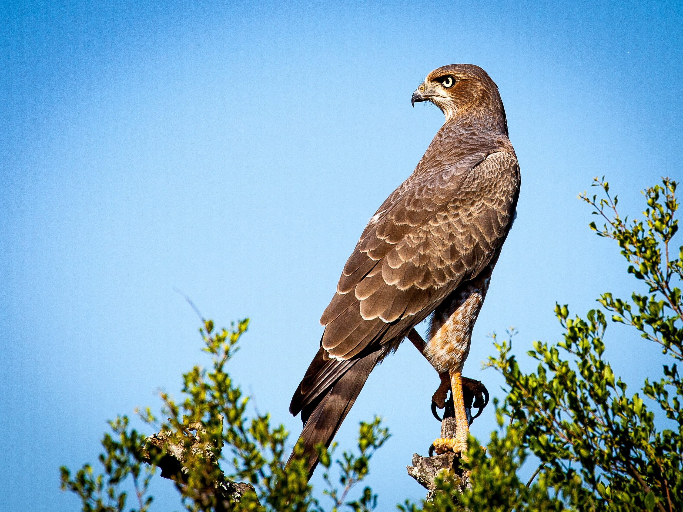
LIVE DEMO

Slide 6
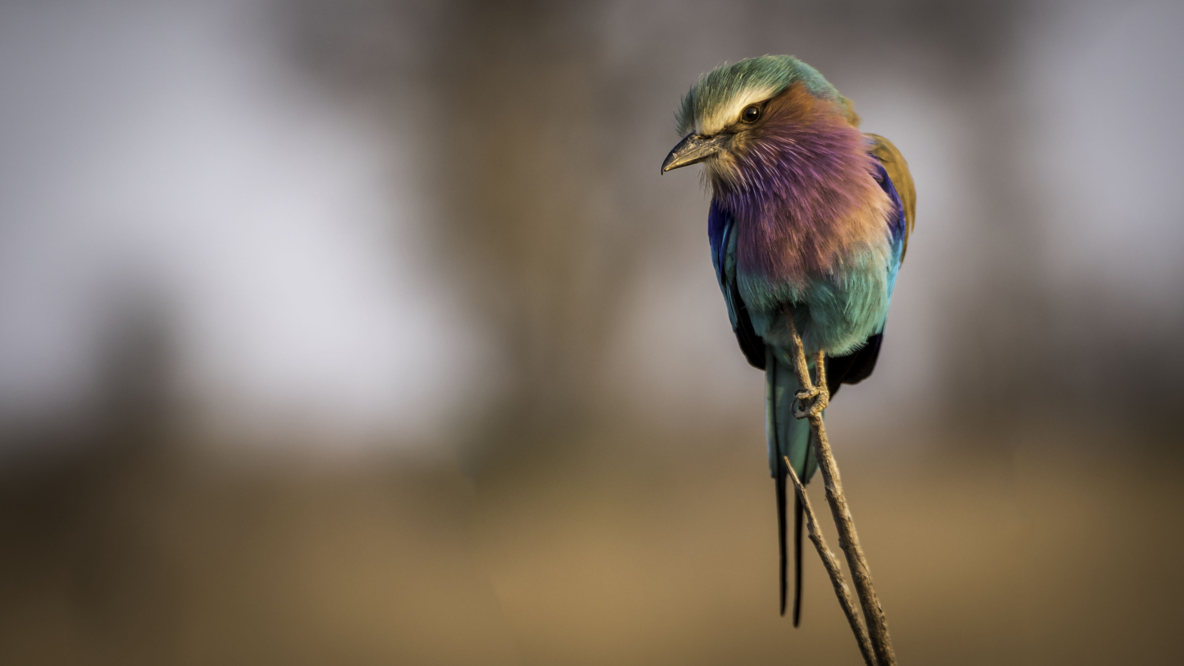
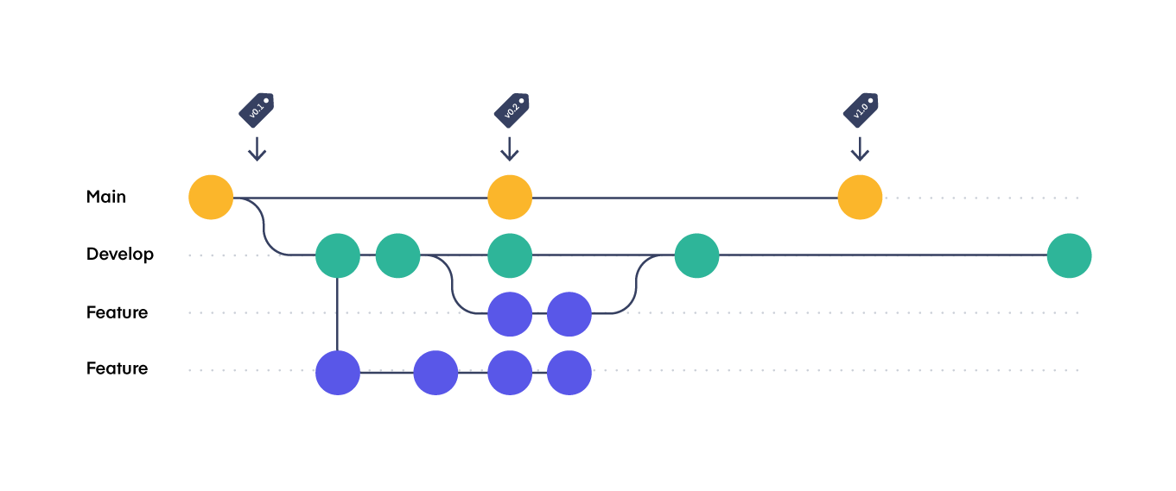
CI/CD
Branching Strategy
Review Process
Simplified Version of GitFlow
+ main
+ dev/feature/*
+doc/*
-release
-hotfix
- A pull request needs to be made before a merge takes place
- Members ask for at least one review before completing a pull request

Slide 7
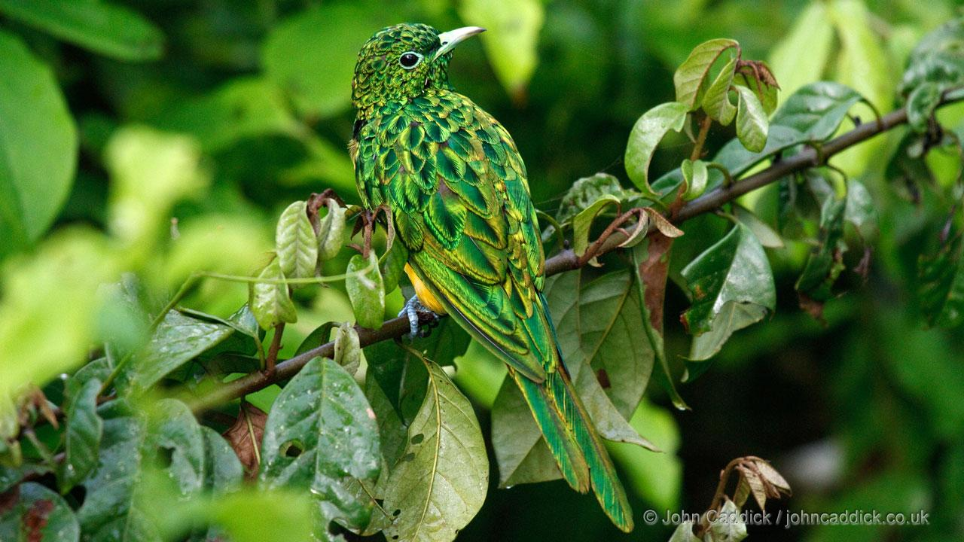
ThankYou
BeakPeek
millennium.capstone@gmail.com
Group 22
Charl Pretorius

